Slide 1

The Embodied Brain Interoception & Physiology
Dominique Makowski
D.Makowski@sussex.ac.uk
Notes:
1h

Slide 2
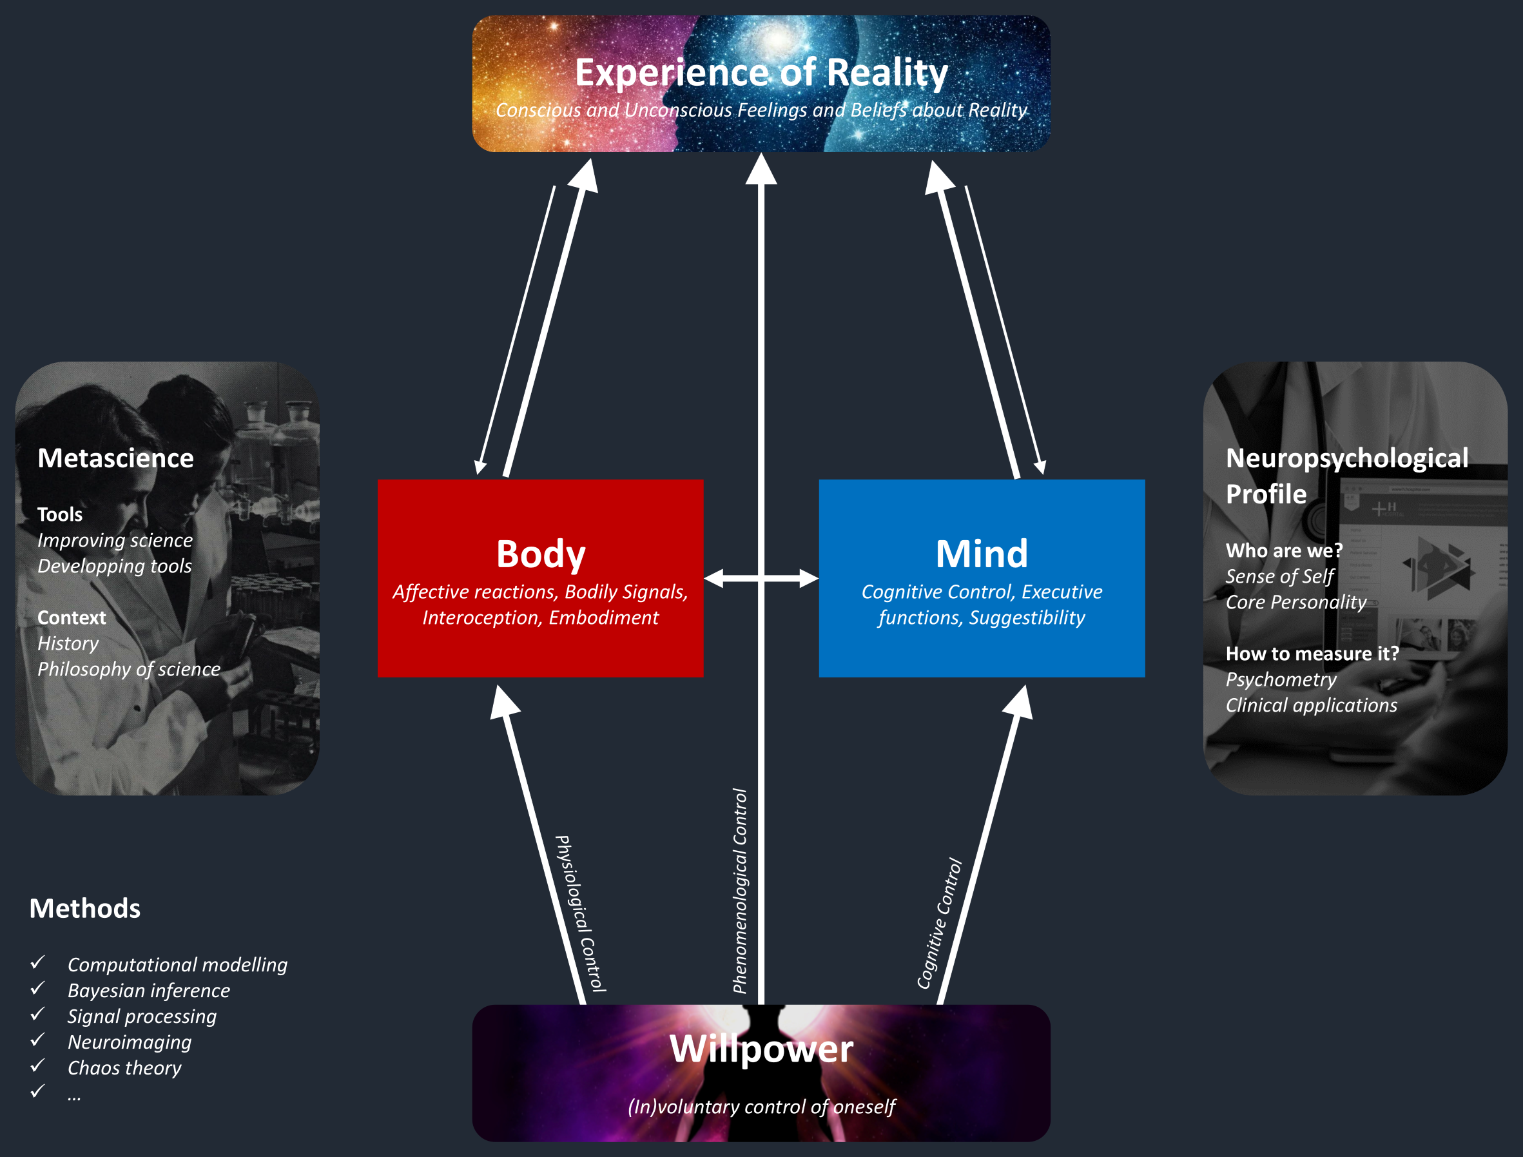

Introductions
Dominique Makowski
Reality Bending Lab
Role of the body in higher cognition
Slides: https://github.com/DominiqueMakowski/teaching
Contact:
D.Makowski@sussex.ac.uk

Slide 3
Body & Mind

Slide 4
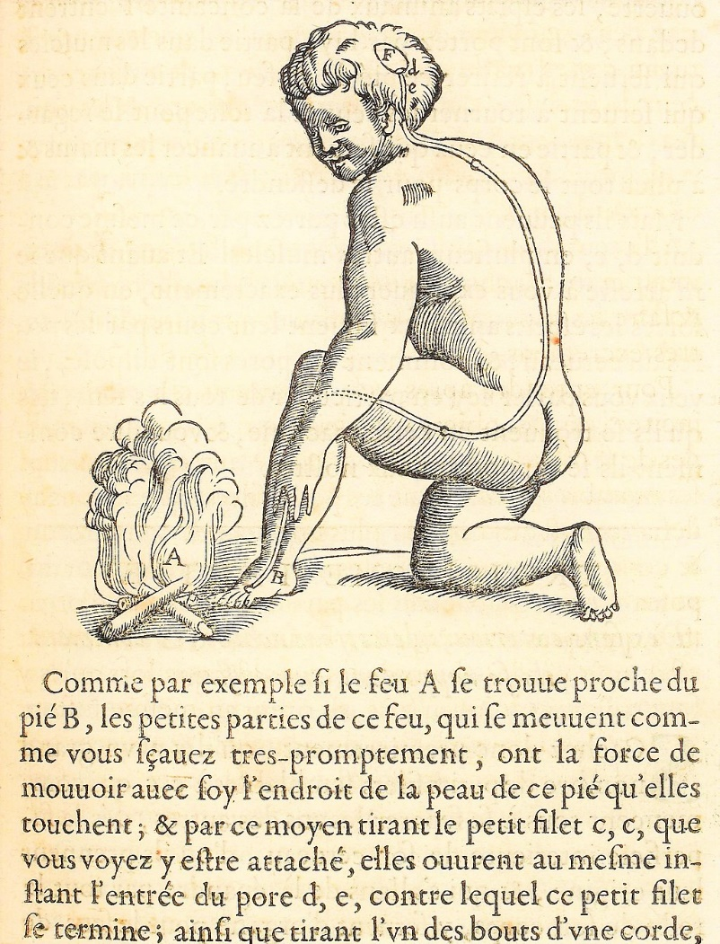
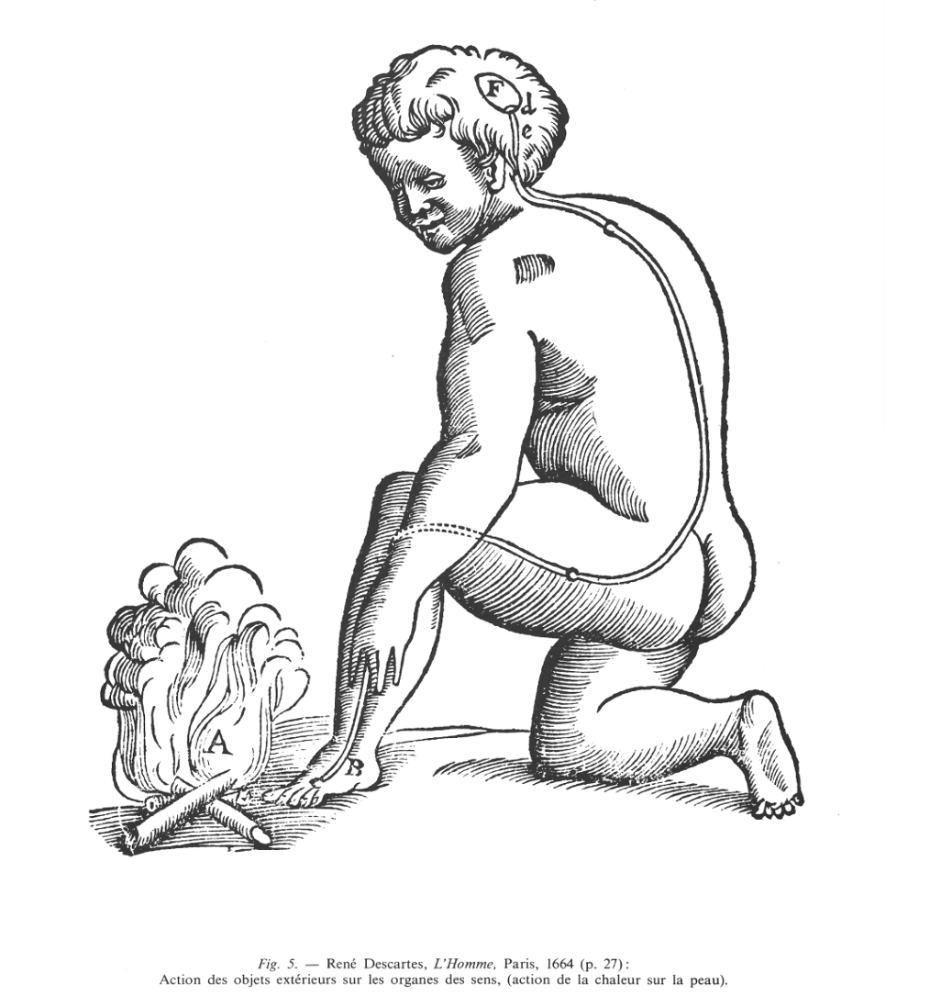
Ghost in the Machine
What is the relationship between the body and the mind?
Long philosophical tradition of “dualism” (e.g., Platonism, monotheisms)
In philosophy of mind, “Mind-body Dualism” denotes the view that the mind and body are distinct and separable, and/or that mental phenomena are non-physical
The “ghost in the machine” (Ryle, 1949) is a term originally used to describe and critique the concept of the mind existing alongside and separate from the body
If they are two different things: how does the mind control the body?
Descartes (1664) in « L'Homme » Treatise on Man
Body and mind are two fundamentally different “substances”
They interface at a special organ: the pineal gland
Body enables the mind to make actions (they do still interact)
Leibniz (1714) in « Monadologie»
Psychophysical parallelism: Mental and the physical phenomena do not interact but only coincide in a “pre-established harmony” (because God set it up that way)
Notes:
substance pensante (res cogitans) et la substance étendue (res extensa)
animal spirits
« Comme par exemple si le feu A se trouve proche du pied B, les petites parties de ce feu, qui se meuvent comme vous savez très promptement, ont la force de mouvoir avec soi l'endroit de la peau de ce pied qu'elles touchent ; et par ce moyen tirant le petit filet c, c, que vous voyez y être attaché, elles ouvrent au même instant, l'entrée du pore d, e, contre lequel ce petit filet se termine ; ainsi que tirant l'un des bouts d'une corde, on fait sonner en même temps la cloche qui pend à l'autre bout. Or l'entrée du pore ou petit conduit d, e, étant ainsi ouverte, les esprits animaux de la concavité F (glande pinéale) entrent dedans et sont portés par lui partie dans les muscles qui servent à retirer ce pied de ce feu, partie dans ceux qui servent à tourner les yeux et la tête pour le regarder, et partie en ceux qui servent à avancer les mains et à plier tout le corps pour le défendre. Mais ils peuvent aussi être portés par ce même conduit d, e, en plusieurs autres muscles. » (Descartes, l’Homme, 1664, p. 27)

Slide 5

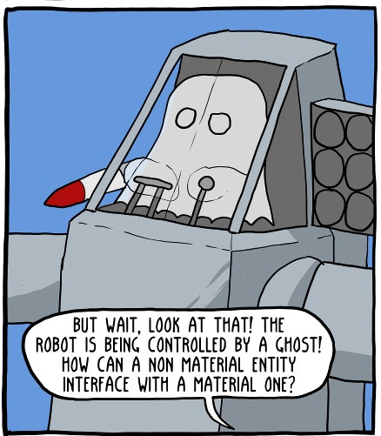
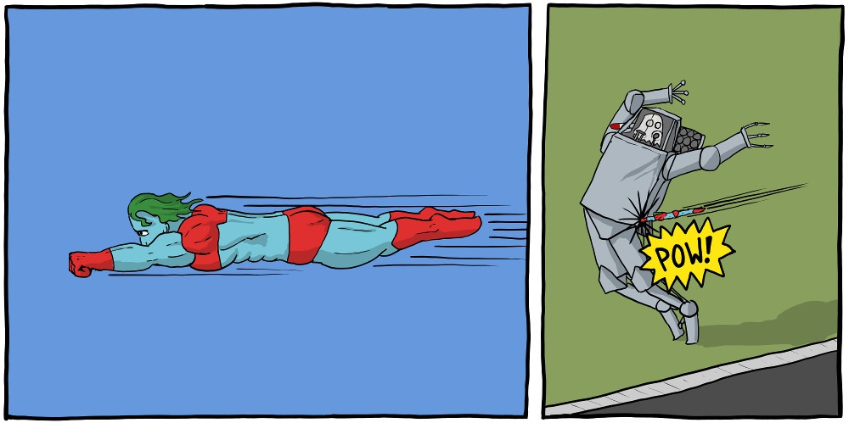
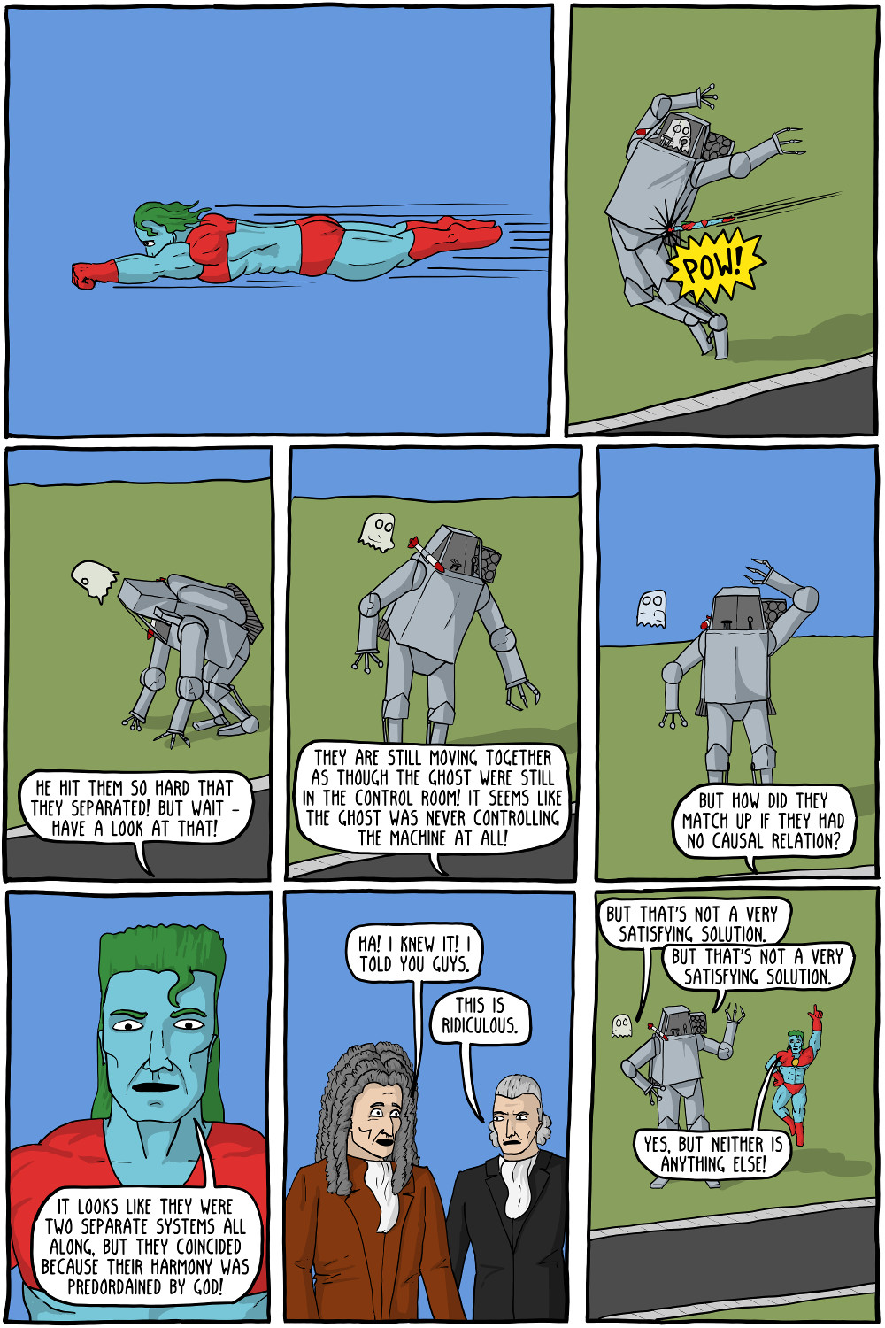
Ghost in the Machine
https://existentialcomics.com/comic/47

Slide 6
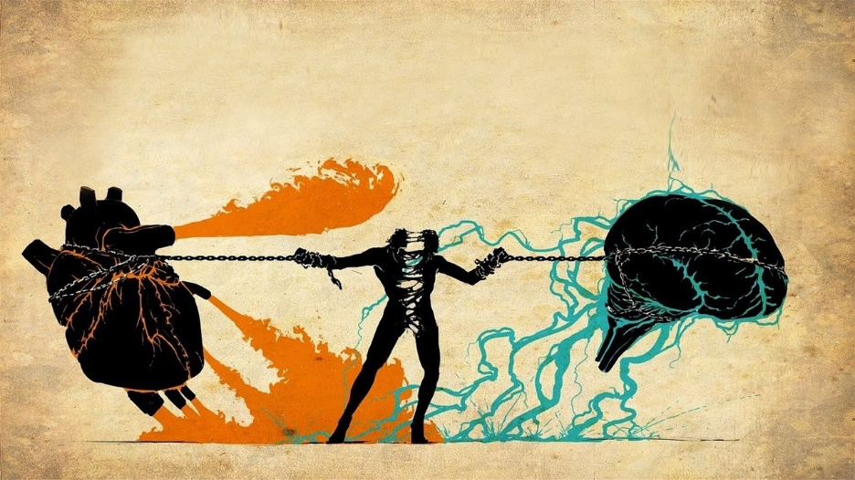
Dualism in the 21st Century
What is the current situation?
Mind–body dualism still has strong echoes in certain domains
E.g., consciousness science: in the existing debate about the relationship between neural processes and conscious experience (the “hard problem of consciousness”; Chalmers, 1995)
Current situation
In cognitive neuroscience & psychology, overall agreement over the fundamental role of bodily processes in shaping cognition
Future comeback?
Reemergence of dualism with views imported from the social sciences (e.g., identity is a fundamentally social construct orthogonal to biological determinants)
AI systems? Advanced cognition without biological bodies?

Slide 7
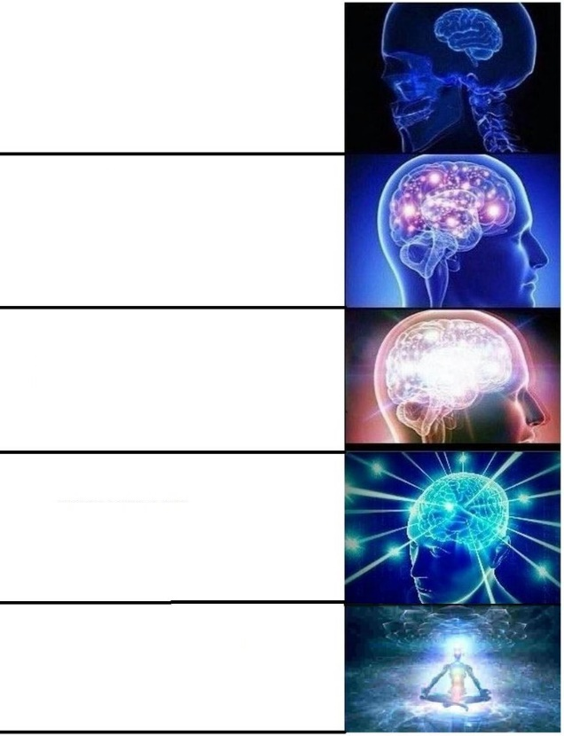
Psycho + Physio?
Embodied cognition: Cognition is shaped by physiological states and capabilities of the organism
Evidence suggests that the fabric of our reality, our conscious experience and sense of Self is embodied
Research interest in the process of embodiment itself (e.g., through interoception, i.e., the way the mind senses and represents its own physiological state)
Psychophysiology: the study of the relationship between physiological and psychological phenomena (i.e., the way in which the mind and body interact)
Study at school
Learn psychology at uni
Get interested in the role of the body in mental processes
See that there is no distinction between your body and your mind
Accept that there is no you but only the one

Slide 8
Interoception

Slide 9


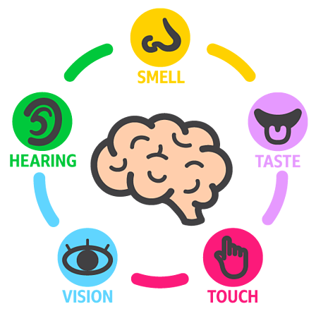



The 5 senses… make little sense
Conscious Experience
« What it’s like to be a bat? » (Nagel, 1974)
Exteroception
Interoception
Taste
Smell
Hearing
Vision
Touch
Body Awareness
Proprioception: Sense of the relative position of one's own body parts
Equilibrioception: Sense of balance and movement (vestibular system)
Interoception
Thermoception: The ability to sense temperature and its changes
Sweat glands (electrodermal activity / skin conductance)
Nociception: Perception of pain
Humoception: Humoral receptors are sensitive to hormones
Visceroception (Interoception)
Bladder
Stomach (hunger, thirst)
Lungs (respiration)
Cardiovascular system (heart)
Sensing of physiological states and changes
Non-human (?)
Magnetoception: sensitivity to magnetic fields
Chemoception - pheromones
Vision – Infrared, ultraviolet
…
Notes:
What about touch?

Slide 10
Interoception Definition
Role
Physiologically, interoceptive signaling is involved in coordinating homeostatic reflexes (e.g., control of blood pressure or glucose levels within a set range) and by guiding predictive (allostatic) autonomic and behavioural responses (e.g., preparing the body for action by increasing blood pressure and heart rate)
Psychologically, interoceptive representations are proposed to underpin both motivational (e.g., hunger) and emotional (e.g., anxiety) feeling states and play an important role in cognition and consciousness (minimal consciousness, sense of reality, …)
Definition
“Interoception is the body-to-brain axis of sensation concerning the state of the internal body and its visceral organs” (Sherrington, 1948)
“Interoception refers to the process by which the nervous system senses, interprets, and integrates signals originating from within the body, providing a moment-by-moment mapping of the body’s internal landscape across conscious and unconscious levels” (Khalsa et al., 2018)
Signaling, processing, representing, and integrating internal bodily states
🔥 Hot topic of research
Notes:
homeostasis = aspects of physiology that maintain life
allostasis = active process of maintaining/re-establishing homeostasis. Dysregulatory (or disordered) form of physiological regulation.

Slide 11
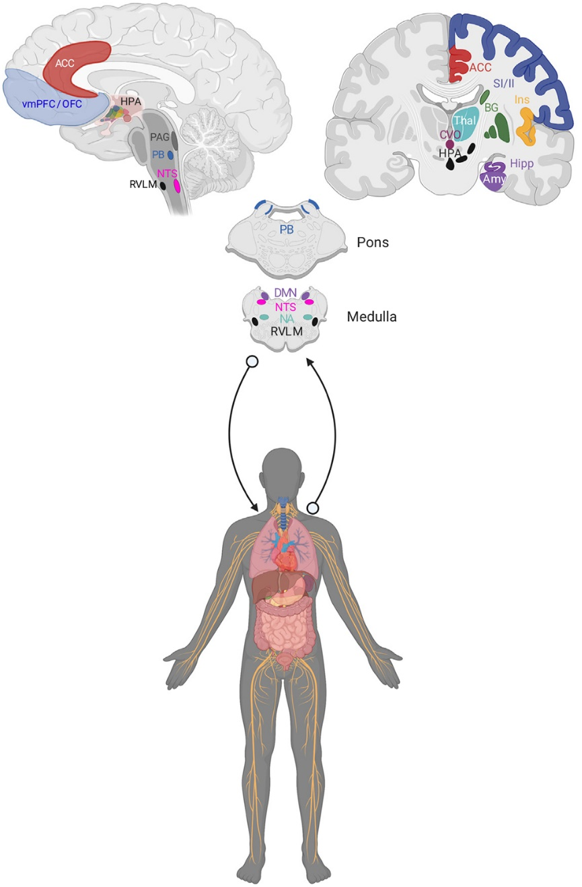
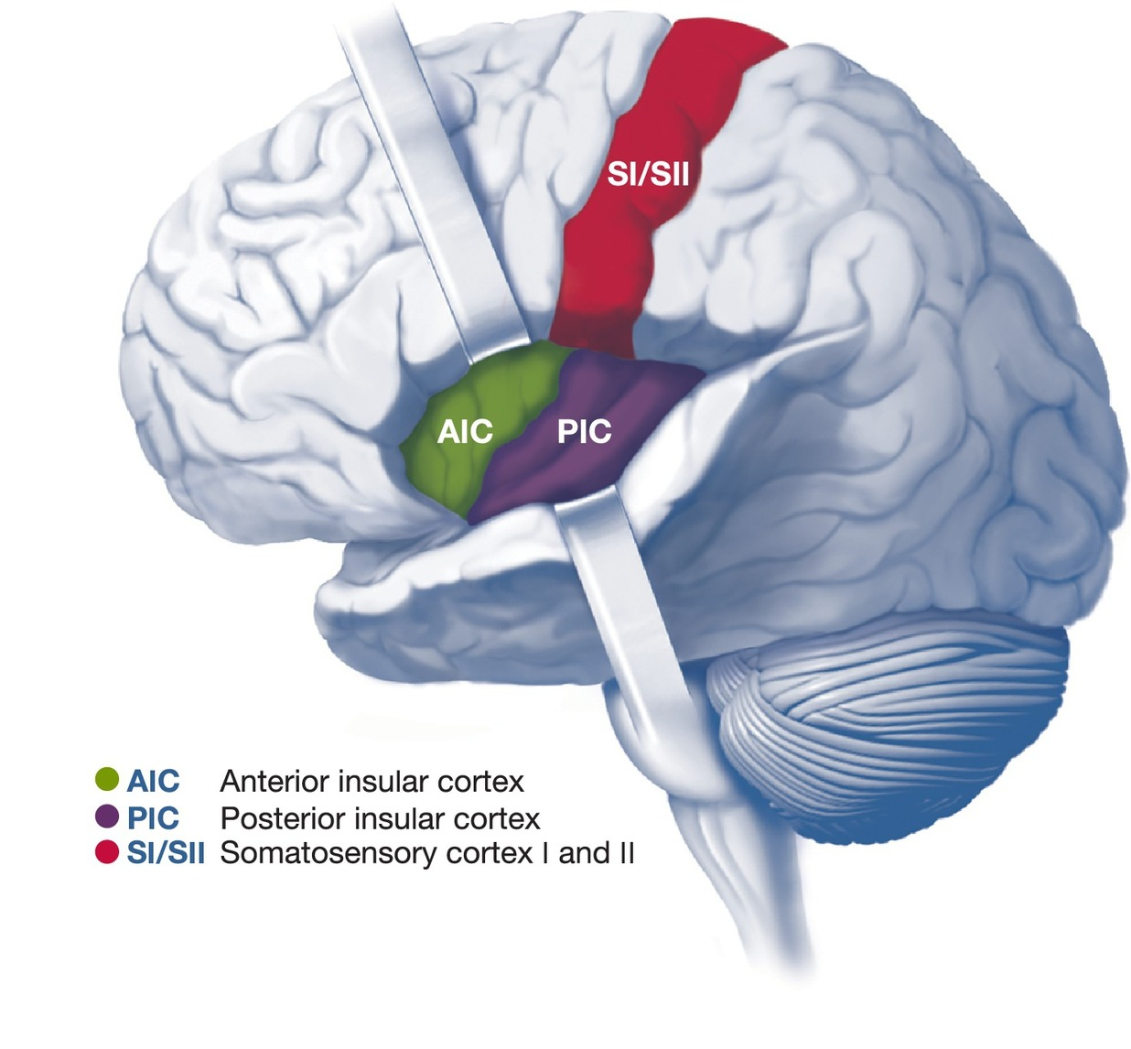
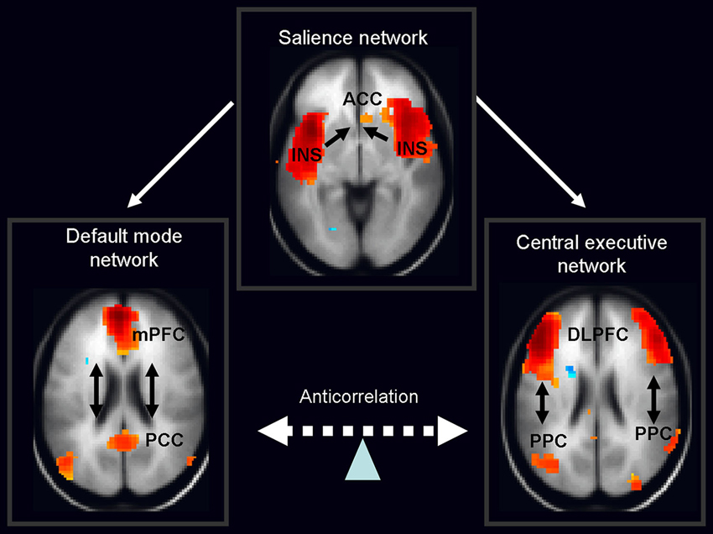
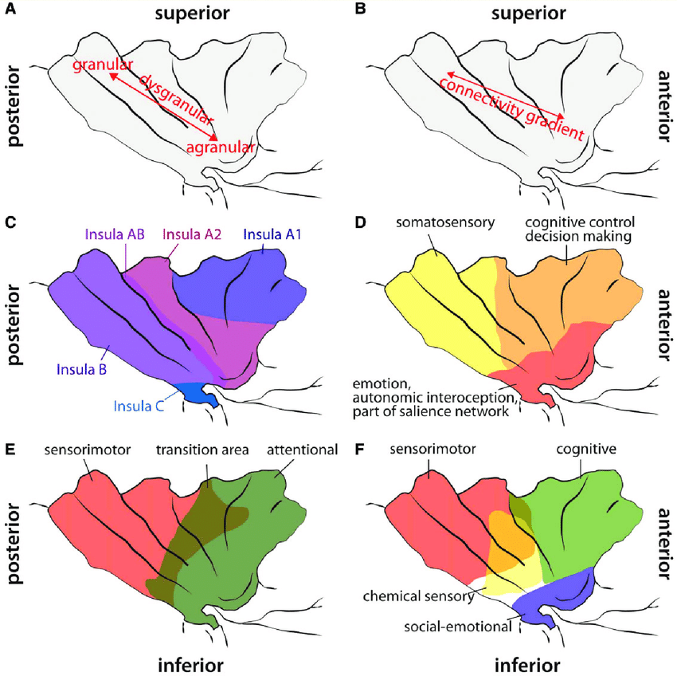
Neural Bases
Receptors (Mechanoreceptors, Chemoreceptors, Baroceptors, …)
The vagus nerve is a major afferent conduit for interoceptive signals (+ also carries parasympathetic efferents)
Subcortical (brain stem, thalamus)
Cortical
Posterior insular cortex (PIC)
Interoceptive information is related from the ventromedial nucleus of the thalamus to the posterior insula
Integration with exteroceptive sensorimotor and proprioceptive information most likely takes place within the posterior / central regions
Anterior insular cortex (AIC)
Strongly connected to orbitofrontal cortex (OFC) and the anterior cingulate cortex (ACC): may be involved in connections between interoceptive and emotional or cognitive states
Postero-anterior insular gradient
The insula is considered to be part of the salience network
Berntson (2021)

Slide 12

Multidimensional?
Does interoception refer to a single process?
Different levels of processing (unconscious sensing -> conscious and purposeful integration)
Partially distinct physiological pathways
Cardioception – the most studied
Respiroception
Gastroception
…
What about “external” interoception (perception of the body via external senses, e.g., odours from the body, looking at oneself, …)
BUT, information likely integrated at a higher level (?)
Is interoception a unified ability?
🤷
Research is needed, but challenging:
How to measure different facets of interoception?
Often requires specific equipment (e.g., psychophysiological signals recordings)

Slide 13
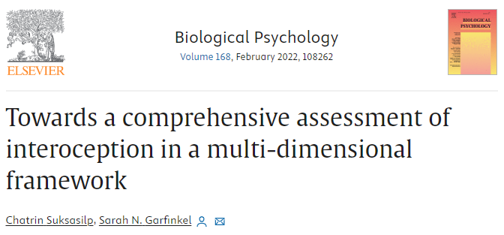
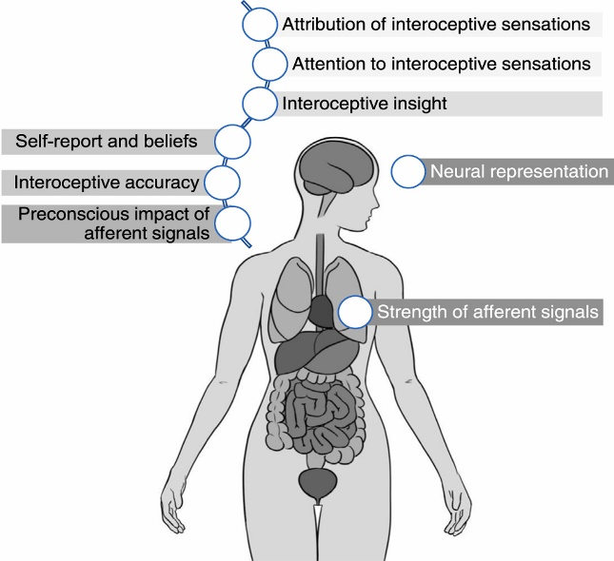
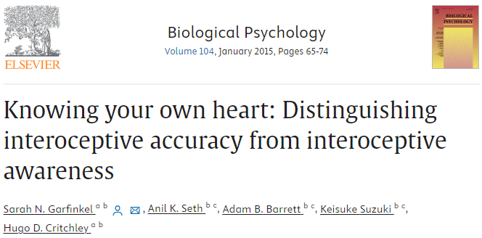
Dimensional models
Interoceptive Awareness
Metacognitive awareness of interoceptive accuracy
3 facets of interoception (Garfinkel et al., 2013, 2014)
Interoceptive Accuracy
Objective performance at interoception tasks
Interoceptive Sensibility
Subjective experience in interoception tasks
Interoceptive Awareness
Metacognitive aspect
Multidimensional model
(Suksasilp, 2022)
Signal strength
Neural representation
Attention orientation
Attribution processes
Beliefs
…
🔥 Active research area
Assessed via subjective awareness of objective accuracy (e.g., correlation between accuracy and sensibility scores)
Interoceptive Accuracy
Objective accuracy in detecting internal bodily sensations
Interoceptive Sensibility
Dispositional tendency to be internally focused; self-reported beliefs about body tendencies
Assessed via objective tests of interoceptive performance (e.g., heartbeat detection tasks)
Assessed via self-report measures (e.g., questionnaires, subjective confidence ratings)

Slide 14
Interoception is an adaptive mechanism
Low interoception is associated with « negative » outcomes (Murphy et al., 2023)
Neuroticism (Pearson & Pfeifer, 2020)
Alexithymia (Gaggero et al., 2021)
Anxiety and panic disorders (Yoris et al., 2015; Eggart et al., 2019)
Eating disorders (Lapidus et al., 2020)
Depression (Eggart et al., 2019)
Borderline Personality Disorder (Flasbeck et al., 2020)
Alcohol and substance abuse (Jakubczyk et al., 2019)
OCD (Schultchen et al., 2019)
Depersonalisation/derealisation disorder (Schulz et al., 2015)
Autism Spectrum Disorder (Nicholson et al., 2019)
ADHD (Kutscheidt et al., 2019)
Schizophrenia (Ardizzi et al., 2016)
High interoception is associated with « positive » outcomes
Extraversion, Openness and Conscientiousness (Ferentzi et al., 2020)
Emotion regulation (Füstös et al., 2013)
Mindfulness (Hanley et al., 2017)

Slide 15
How can you measure interoception?

Slide 16
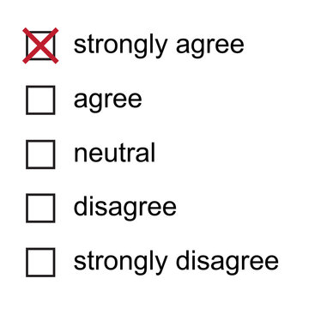
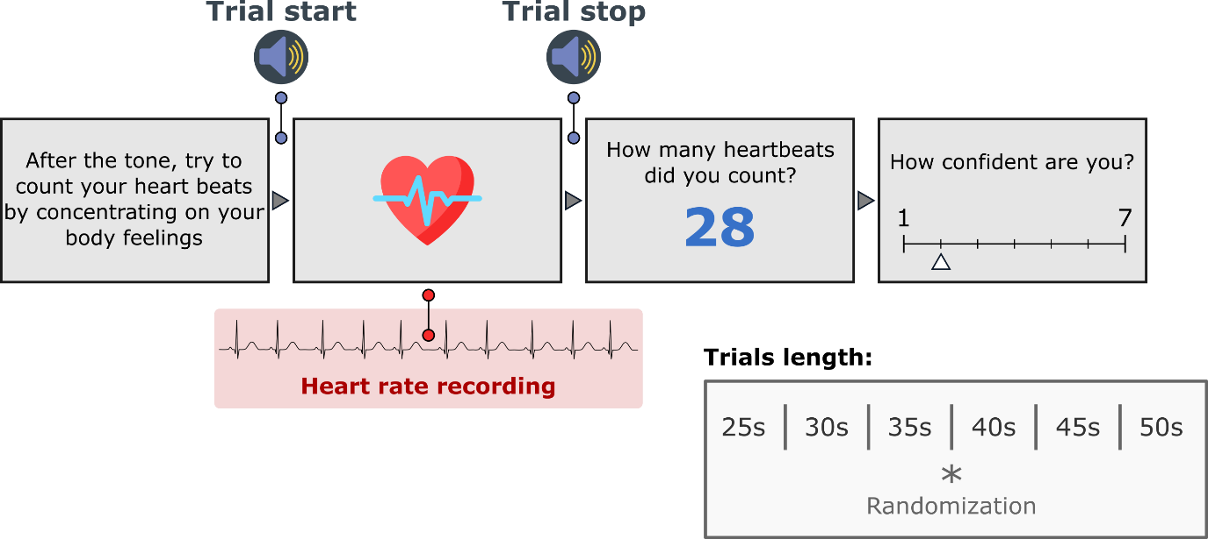
Interoception Tasks
Questionnaires
MAIA (Mehling, 2018)
“I can return awareness to my body if I am distracted”
“When I feel overwhelmed I can find a calm place inside”
Interoceptive Accuracy Scale (IAS; Murphy, 2020)
“I can always perceive when my heart is beating fast”
“I can always perceive when I am going to vomit”
Cardioception
Heartbeat Counting Task (HCT, Schandry, 1981)
Most popular task
Most criticized

Slide 17
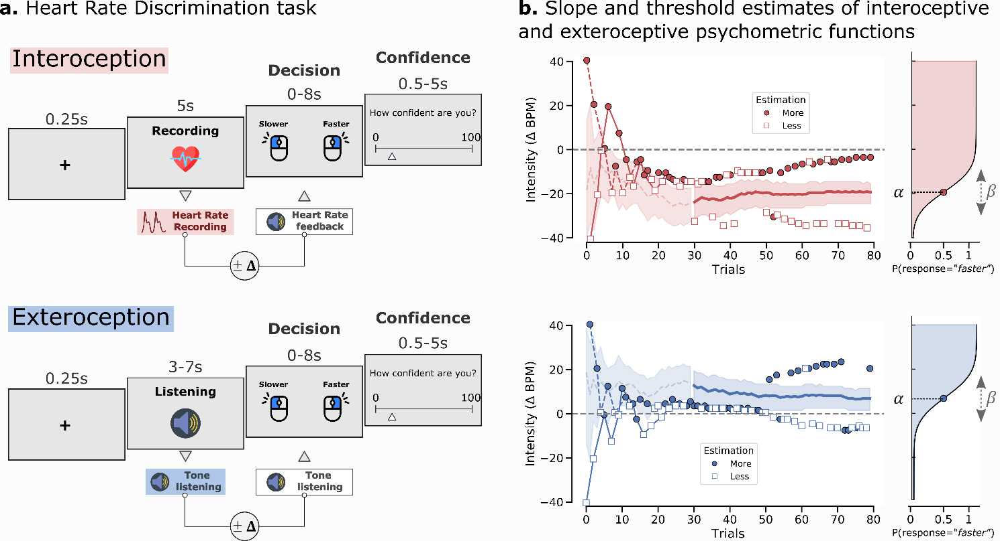
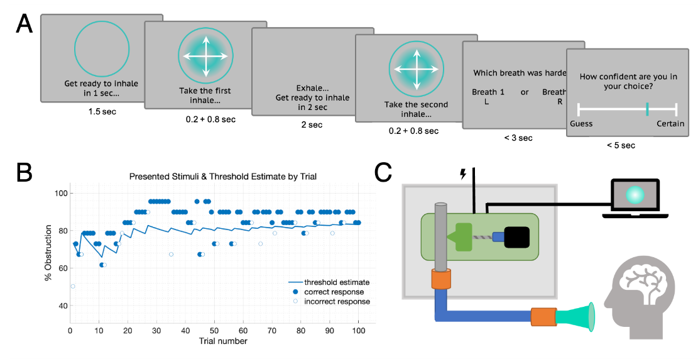
Psychophysics-like Paradigms
Cardioception
Heart Rate Discrimination Task (Legrand et al., 2022)
Respiroception
Respiratory Resistance Sensitivity Task (Nikolova, 2021)

Slide 18
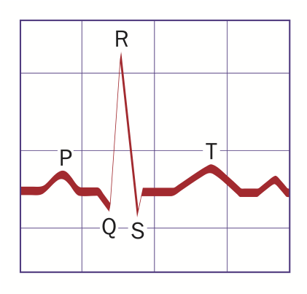
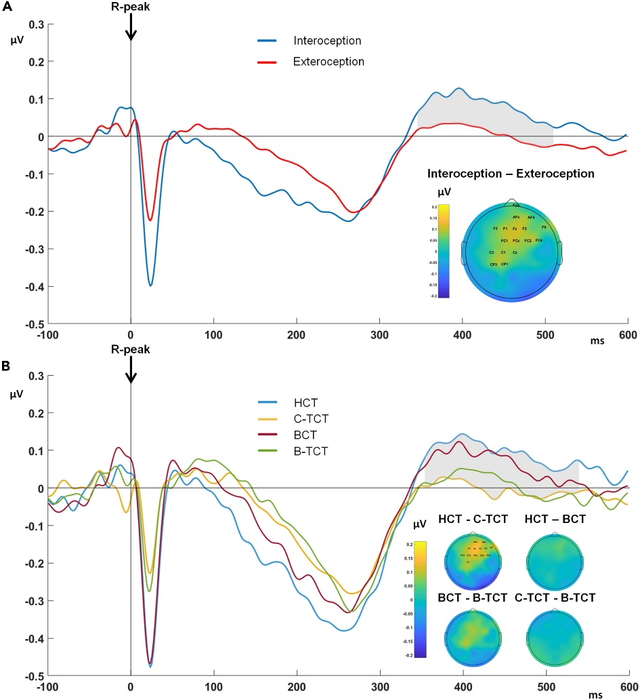
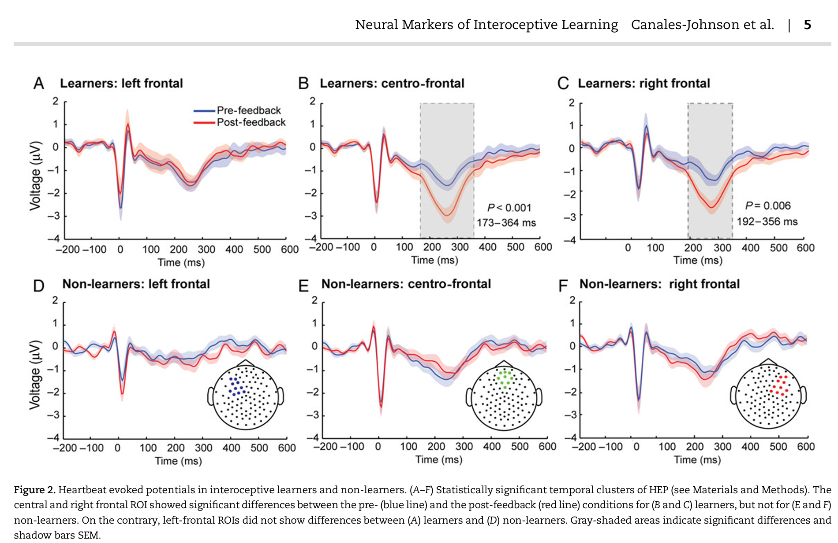
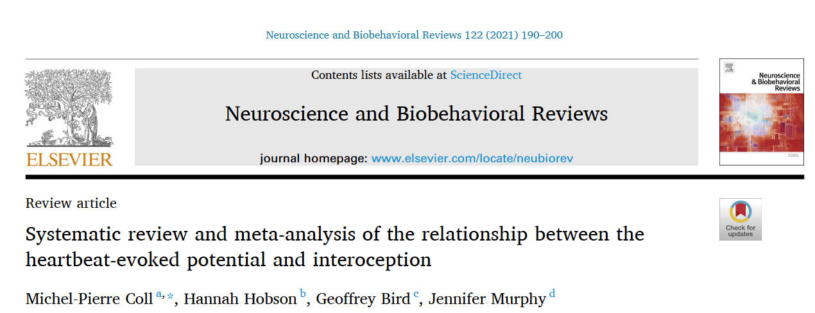
Neuroimaging
Heartbeat Evoked Potential (HEP)
Marker of the “processing” of heart beats in the brain
Potentially a direct marker of cardioception
But:
Moderate association between HEP amplitude and behavioural measures of interoception (Coll, 2021)
Unclear topology & timing
Lack of standardized protocols
Unclear meaning (cognitive elaboration? Preconscious?)

Slide 19
Measuring Interoception
Direct
Capturing interoceptive processes
Indirect
Measuring the coupling between physiology and neurocognition
Objective
Signalling and processing aspects
Subjective
Conscious metacognitive interpretation
Ability level
Characteristics related to coupling
Mechanism level
Measures of
psychophysiological coupling
Implicit
Bypass conscious & metacognitive processes
Explicit
Ask participants to consciously attend interoceptive processes
Examples
of measures
EEG
Heartbeat Evoked Potentials (HEPs) and Fluctuations (HEFs)
Tasks
Heartbeat Counting Task
Heartbeat Tracking Task
Heartbeat Discrimination Task
…
Questionnaires
MAIA, IAS…
Self-reports
Scales of confidence / performance
Assessment of related traits
Emotional reactivity / regulation (?)
Alexithymia (?)
Mindfulness (?)
…
Physiological indices
Heart Rate Variability (HRV)
Effect of cardiac phase
…

Slide 20
Quizz
True / False?
Descartes located the centre of consciousness in the insula
Thanks to science, body-mind dualism is a thing of the past
The Insula is a brain region devoted to « disgust » as one of the 5 basic emotions
The posterior insula is the most tightly connected region with prefrontal cortex
Interoception is a multidimensional construct
Having high interoception is bad
There is only one proper way of measuring interoception
Subjective measures (e.g., questionnaires) of interoception are by definition invalid
The heartbeat counting task is the most popular interoception task
Heartbeat evoked potentials are the brain waves happening at the time of R-peaks

Slide 21
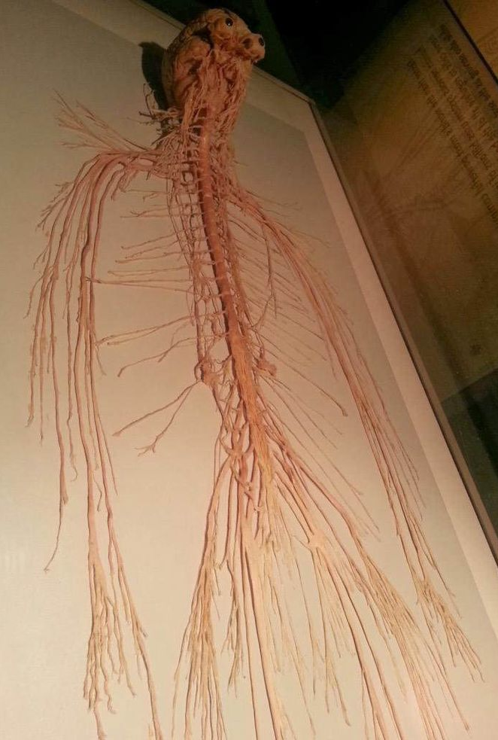
Neuroanatomy Below the brain
This is literally me

Slide 22
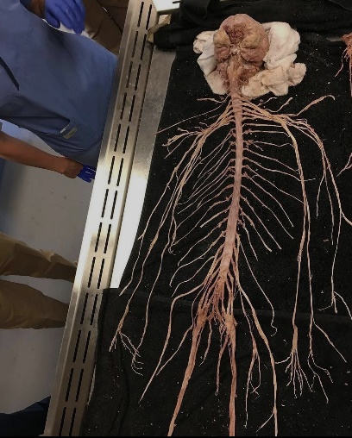
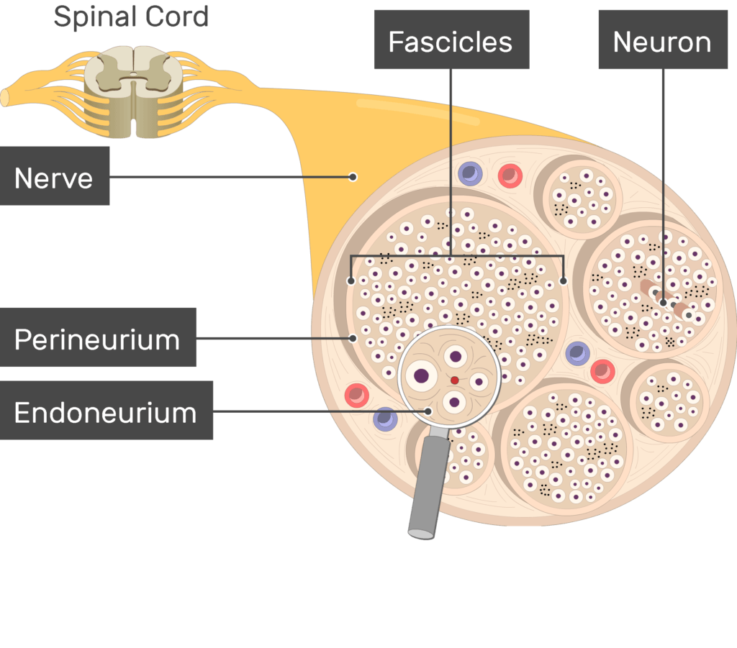
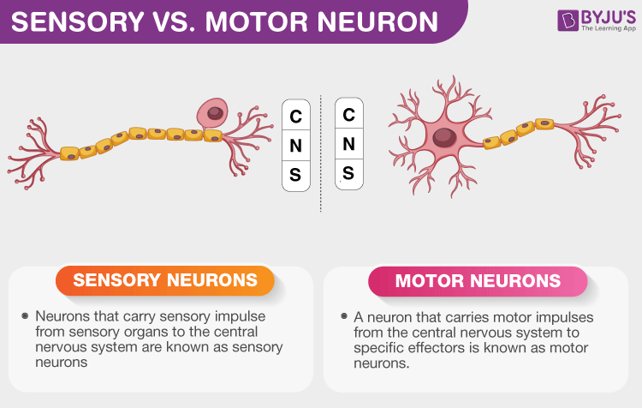
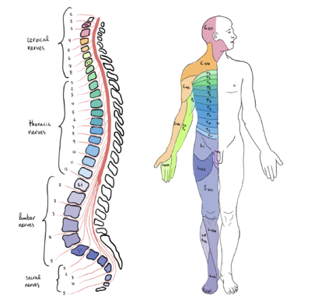
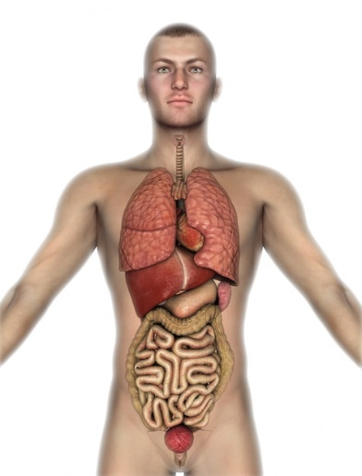
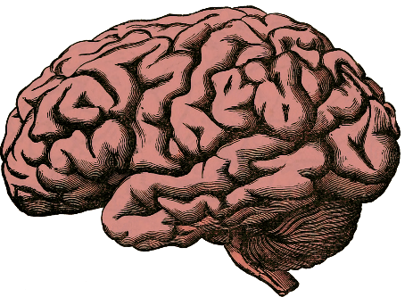
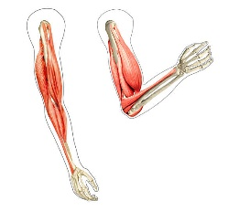
Anatomy
Nervous System
Peripheral Nervous System
Central Nervous System
Sensory neurons
Motor neurons
Brain
Spinal Cord
Somatic Nervous System
Autonomic Nervous System (ANS)
Sympathetic
Parasympathetic

Slide 23
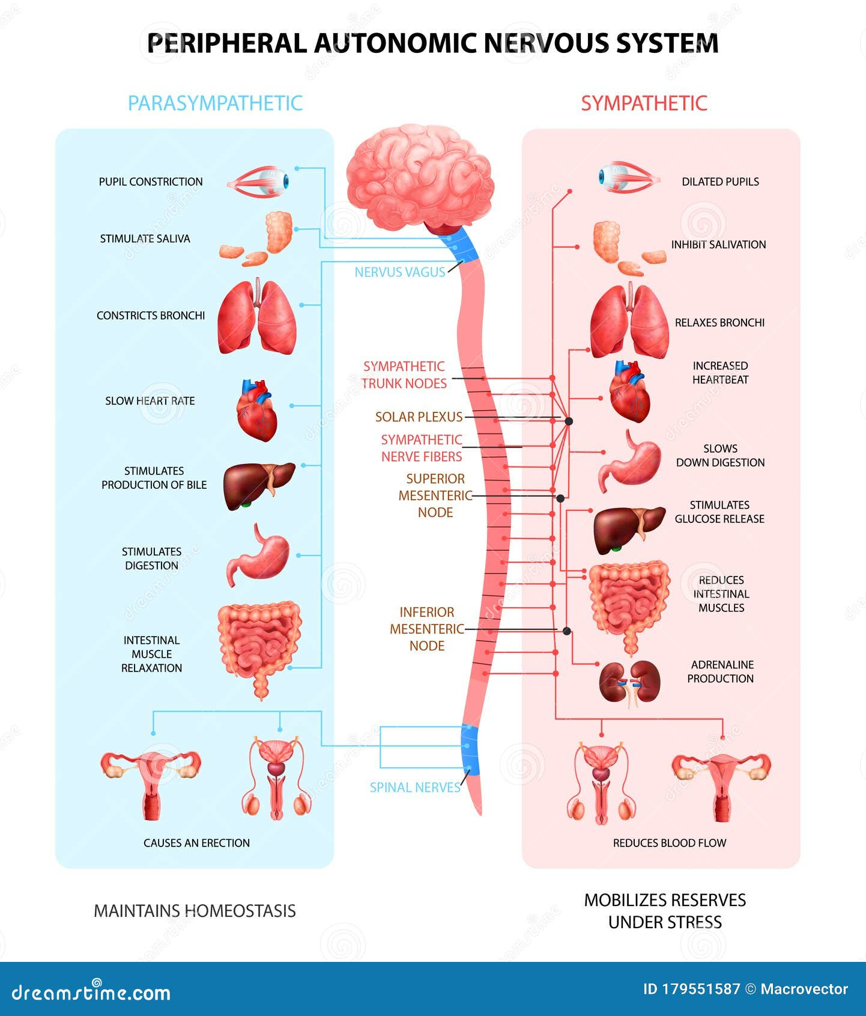
Autonomic Nervous System
The autonomic nervous system (ANS) controls autonomous body processes (blood pressure, breathing, digestion, heart beating, urination, …)
Sympathetic nervous system (SNS)
The Stimulator (accelerates heart rate, constricts blood vessels, and raises blood pressure)
Prepare the body for action (stressful or energetic activity)
Triggers a “sympathy” of the organs (concerted action)
Parasympathetic nervous system (PNS)
The Inhibitor (slows heart rate, increases intestinal activity, and other calming functions)
Dominates during rest state
Mediated (75%) by the vagus nerve
Enteric nervous system (ENS)
Governs the function of the gastrointestinal tract
Partly independent, but interacts with PNS and SNS
Nicknamed the “second brain”

Slide 24
Quizz
True / False?
The peripheral nervous system encompasses everything below the neck
The sympathetic nervous system was named because it expresses sympathy by calming the body
The vagus nerve is the most important nerve of the PNS
The SNS controls the heart rate, accelerating and decelerating it when required
When I’m dozing off after lunch, my parasympathetic system is predominant
Erectile dysfunction can sometimes be caused by a domination of the SNS
The gut is completely independent from the rest of the nervous system
Nervous System
Central Nervous System
?
Brain
?
Motor neurons
?
Somatic Nervous System
?
?
?

Slide 25
At the Heart of Psychology

Slide 26
Cardiac Activity (ECG & PPG)

Slide 27
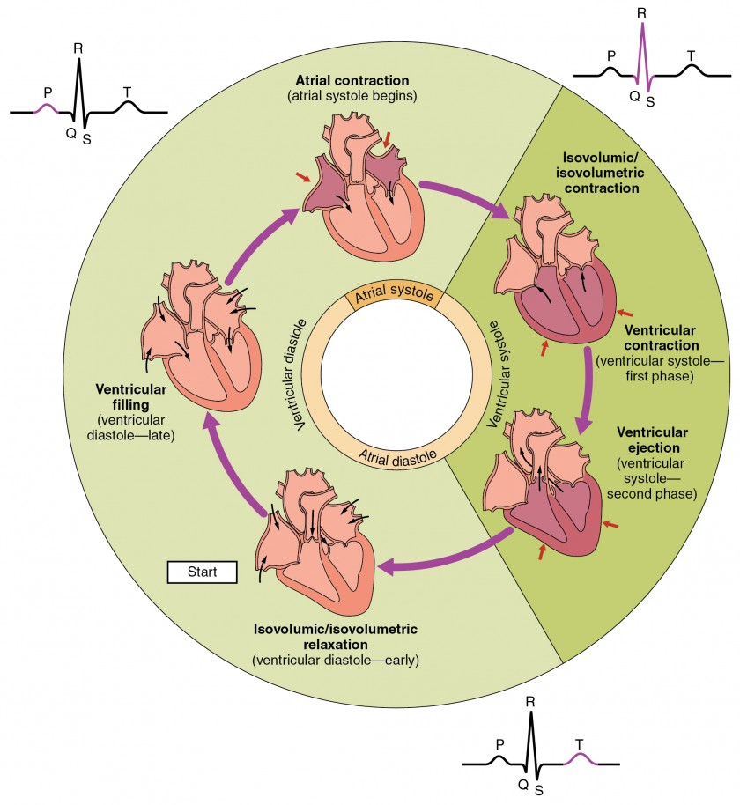
Cardiac Anatomy
2 Parts
Atria: upper chambers (receives blood from the veins)
Ventricles: lower chambers (sends blood to body through arteries)
2 Phases
Systole = Muscle contraction (ejects blood)
Diastole = Muscle relaxation (fill with blood)
Cardiac Cycle
Atria pumps blood to ventricles (atrial systole)
Ventricles pumps blood to body (ventricular systole)
Relaxation and filling up of atria (diastole)

Slide 28
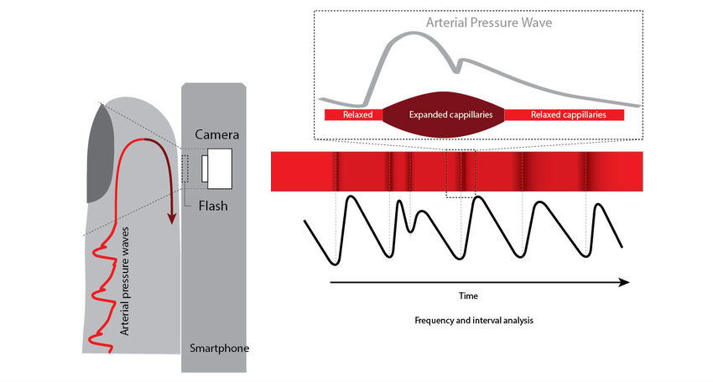
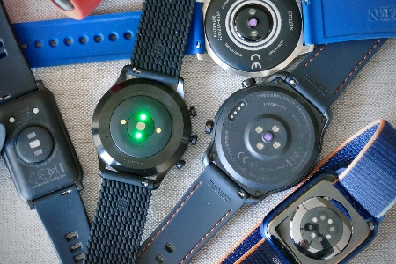
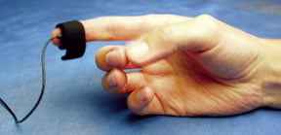
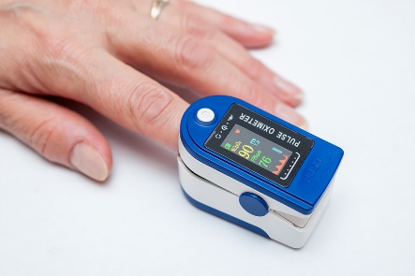
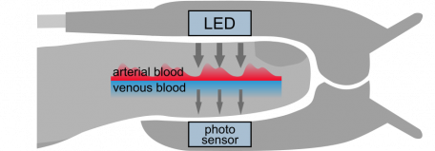
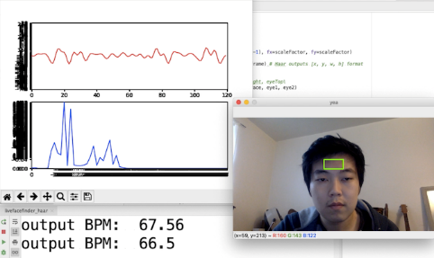
Photoplethysmogram (PPG)
Photoplethysmogram (PPG)
“photo” means “light” and “plethysmos” means “to increase”
≈ Blood Volume Pulse (BVP)
Equipment
PPG can be obtained from transmissive absorption (fingertip, earlobes) or reflection (forehead)
Pulse Oximetry: illuminates the skin and measures changes in light absorption related to blood oxygen saturation
rPPG: remote PPG via webcam by measuring the natural skin colour microvariability
Easiest way to record cardiac activity data
Easily available (wearables)
Measures peripheral blood flow (Pulse)
Indirect measure of cardiac activity

Slide 29
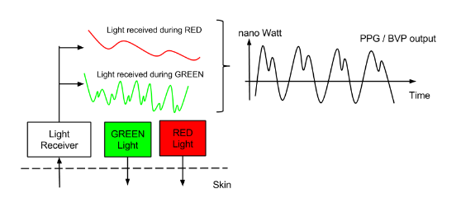
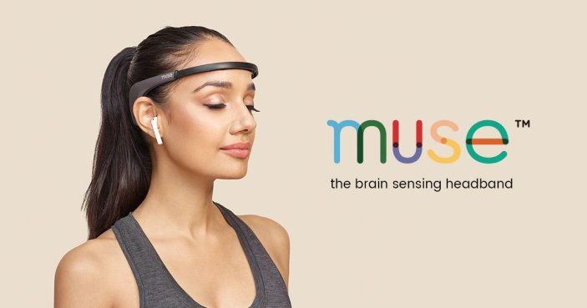
PPG signal(s)
Traditionally, only the infrared (IR) signal (approximately 940 nm) is used for PPG: more stable over time compared to the red signal (660 nm), which is more susceptible to changes in the oxygen saturation
Green + Red light is also sometimes used instead of IR
Unit: unitless (relative changes) because no standardization procedure
Recommended minimum sampling frequency: > 200 Hz (200 datapoints per second)
PPG is the name of the raw signal and BVP usually corresponds to filtered signal (removing slow drifts to isolate the cardiac pulse)
Increases in BVP amplitude indicate vasodilation of the capillary bed → parasympathetic response
Decreases in BVP amplitude indicate vasoconstriction of the capillary bed → sympathetic response

Slide 30
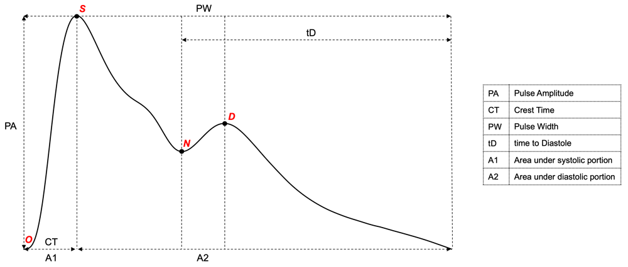
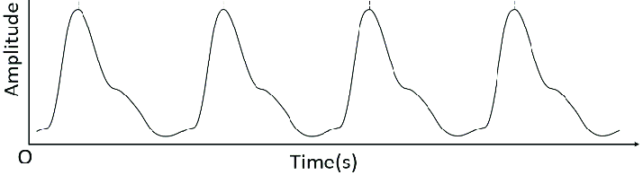
Pulse Waveform Morphology
Pulse waveform is related to the central aortic pressure wave, and is the combination of:
A systolic wave caused by the increase in pressure, and therefore volume, arising from left ventricular contraction and ejection of oxygenated blood into the arterial system
A second reflectance wave, often referred to as the ‘diastolic’ wave
The “perfect” pulse wave has 2 peaks
In practice, often one.
OSND = the predominant fiducial points:
O - Origin
S - Systolic peak
N - Dicrotic notch
D - Diastolic peak
Morphology of the waveform could carry psychophysiological meaning
Adrenaline (i.e., epinephrine) infusion resulted in generalised vasodilation and a lowered diastolic portion relative to the systolic wave
Noradrenaline (i.e., norepinephrine) infusion, which conversely increases peripheral resistance, resulted in a relatively heightened diastolic portion
Waveform characteristics could be potentially related to physiological arousal & interoception (more studies are needed)
Williamson et al. (2022). The Hybrid Excess and Decay (HED) model: an automated approach to characterising changes in the photoplethysmography pulse waveform.

Slide 31
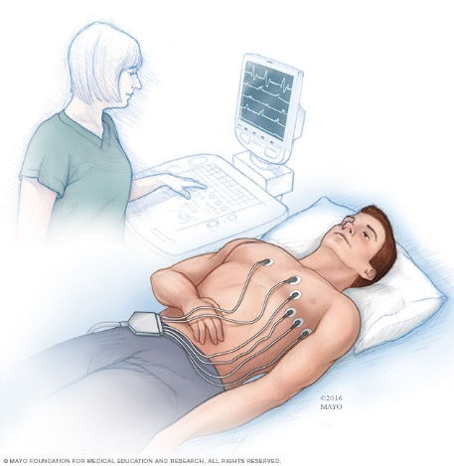
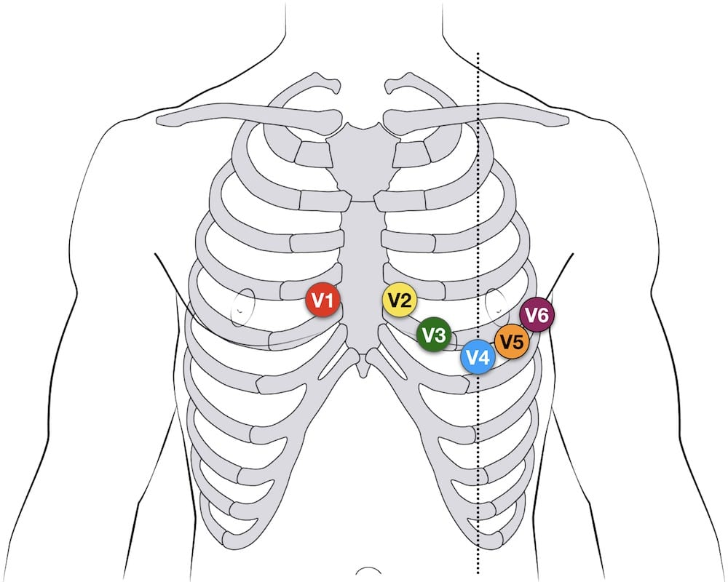
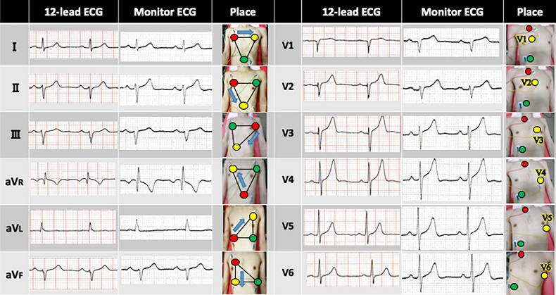
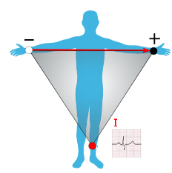
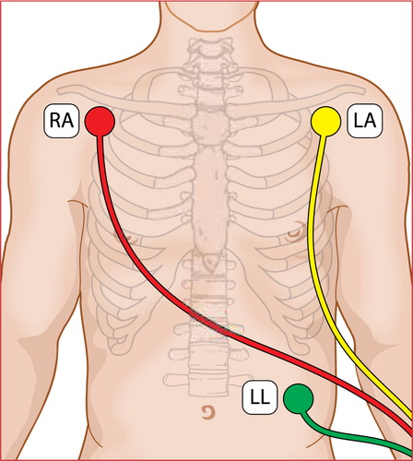
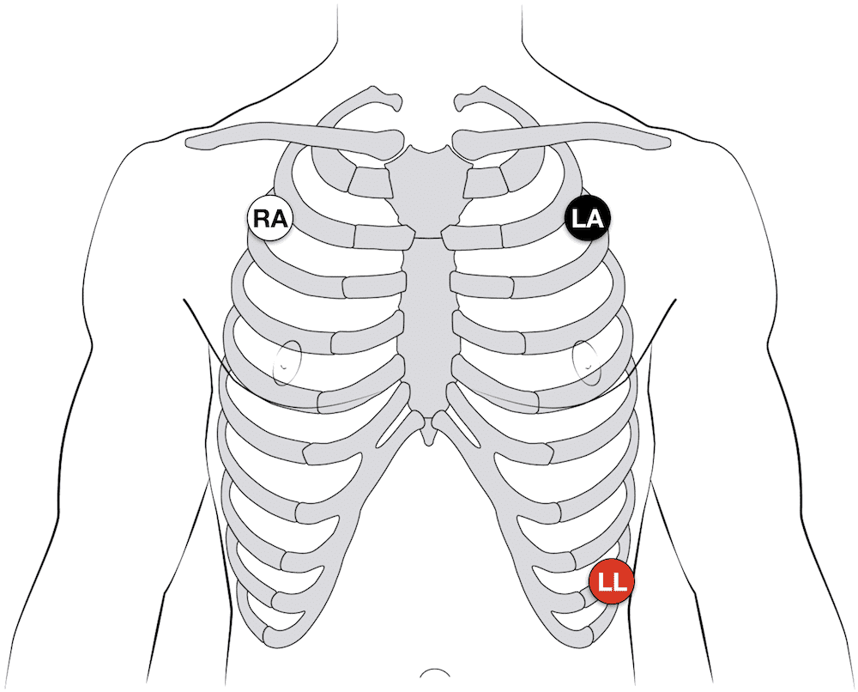

Electrocardiogram (ECG)
Electrocardiogram (ECG)
= EKG (elektrokardiogramm in German)
Equipment
Multilead (12-lead)
6 electrodes
Used in cardiology
Magnify different features of the cardiac complex
Single lead
Used in psychophysiological research
3 electrodes (+, -, and REF)
Often white (-, RA), black (+, LA), red (REF, LL)
Different possible configurations (lead I most popular)
Possibility of distal placement (arms and leg) at the cost of signal quality
Cardiac Complex = QRS Complex
R-peak: most important feature
P, Q, S, T waves
Lead I
- +

Slide 32


Cardiac Phase
Cardiac Phase (most studies focus on ventricular phase)
Systole (ventricular)
Blood is ejected through the arteries
Arteries expansion activates the baroreceptors (pressure sensors)
Cardiac state (strength and timing) is relayed to the brain
Diastole
During diastole baroreceptor are quiescent
ECG Signal Delineation
Identifying the location (+ beginning / end) of QRS waves
Important for precise cardiac phase indentification
Systole = from R-peak to end of T-wave
Hard to do algorithmically (+ requires good signal)
Heuristics have been used (e.g., systole 0-300 ms post R-peak)
But do not take into account inter & intra-individual variability

Slide 33




Cardiac Phase influences Behavior
Evidence suggesting that behavior is coupled with the cardiac phase
Motor action (Palser, E. R., Glass, J., Fotopoulou, A., & Kilner, J. M. (2021). Relationship between cardiac cycle and the timing of actions during action execution and observation. Cognition, 217, 104907)
Information gathering (Galvez-Pol, A., Virdee, P., Villacampa, J., & Kilner, J. (2022). Active tactile discrimination is coupled with and modulated by the cardiac cycle. Elife, 11, e78126)
Visual search (Galvez-Pol, A., McConnell, R., & Kilner, J. M. (2020). Active sampling in visual search is coupled to the cardiac cycle. Cognition, 196, 104149)

Slide 34




Cardiac Phase: Effect on Cognition
Mechanism
During the cardiac ejection period (systole), arterial baroreceptors signal cardiovascular arousal to brain stem (medulla), which is then relayed to other regions, such as the anterior cingulate cortex (ACC), amygdala and insula (but anatomo-functional link between cardiac phase and brain activity still poorly understood)
Effects
“Inhibitory effect” of systole (Lacey and Lacey, 1978)
Nociception attenuated during systole (Edwards, 2001, 2002)
Memory encoding worse during systole (Garfinkel, 2013)
Time perception contracts during systole (Arslanova, 2023)
Emotions (Garfinkel, 2014)
Cognitive control (Makowski, 2020)
Awareness (Park, 2014)
🔥 Hot topic of research

Slide 35



Heart Rate
Peaks identification is a critical processing step
Various algorithms exist with strengths & limitations
Heart Rate Computation
Peaks indices
Compute “period”: Consecutive Differences R+1 – R in seconds
These are “R-R intervals” (RRi)
= Inter-beat Intervals (IBI)
≈ Normal to Normal Interval (NN)
RRi corresponds the “reverse” of heart rate (HR)
= Larger values = longer interval = lower rate
Heart Rate (HR) = Number of beats per minute (in BPM)
Interpolation: often the values of HR (which are discrete) are interpolated (what method? Often: assumption of a continuous process)
Rate computation is also used with other signals that have discrete events (e.g., peaks) such as PPG, Respiration, Blink rate, ...
Heart Rate is complex

Slide 36



Heart Rate Deceleration
Momentarily deceleration (= briefly increase of RRi) of HR often following an “event” (e.g., stimulus presentation)
Short range change (0 – 5 s)
An event-related form of Heart Rate Variability (HRV)
Observed in
Affective processing
Attentional orientation & engagement
Awareness
Different possible indices
Amplitude of deceleration (e.g., min([0-5 s]) - baseline)
Speed of deceleration (e.g., time-to-min)

Slide 37
Cardiac Indices
Predictive Indices
Cardiac phase (systole vs. diastole)
Heart rate at stimulus onset (index of arousal)
…
State-related Indices
Average of heart rate in a given task / condition
Heart Rate Variability (HRV)
…
Event-related Indices
Heart Rate deceleration (amplitude, speed, …)
…
Cardiac activity is a highly reactive measure conveying information about physiological states, and their interaction and integration with neurocognition.
It is a very rich signal (= many indices can be extracted) with important applications in psychophysiology and interoception, that continues to be a promising area of research

Slide 38
Quizz
True / False?
BVP corresponds to « Business Value Proposition » and has nothing to do with physiology
PPG is a cost-effective way to record cardiac activity-related data
PPG can only be estimated by sending infrared light through the finger
OSND stands for « Obviously Sussex No Danger»
QRS stands for « Quality Resting State »
Systole corresponds to the blood ejection phase
ECG signal delineation corresponds to the process of identification of the various waves
Ventricular Diastole is from the end of the T-wave to the next R-peak

Slide 39
Heart Rate Variability (HRV)

Slide 40

Heart Rate Variability (HRV)
A complex and constantly changing heart rate is an indicator of healthy regulatory systems that can effectively adapt to sudden environmental and psychological challenges
Higher HRV = more adaptive nervous system
Higher HRV associated with positive outcomes (physical & mental health)
Reduced HRV associated with poor cardiovascular health outcomes, vascular diseases, mental disorders and cognitive impairments
Many systems influence HR at the same time, which operate on different time scales. HRV is itself distributed across different frequency bands, with a mix of high and low frequency changes corresponding to different neurophysiological mechanisms

Slide 41

High vs. Low Frequency Variability
HRV contains a mix of variability at different time scales
Rapid HR changes reflect the cardiac regulatory influences of the autonomic nervous system (ANS), in tandem with its dynamic interaction with cardiovascular and respiratory activities (Respiratory Sinus Arrythmia - RSA).
Measures the “baroreflex”, one of the body's homeostatic mechanisms that constantly adjust HR to maintain a steady blood pressure. The stronger the baroreflex, the more frequently the HR is adjusted to maintain a stable level of blood pressure. Greater high-frequency HRV = stronger baroreflex.
Slow HR changes reflect bodily fluctuations of lower frequency, such as circadian rhythms, sleep cycles, metabolism, and changes in body temperature and hormonal systems
In practice, the length of recordings naturally limits the sources of variability that can be quantified.

Slide 42




HRV indices
HRV is a popular physiological “index”
But it is not a single “index”
More than 100 existing indices…
🔥 Their structure and organization is an active area of research
Mathematical Classification (practical approach)
Time-domain: SDNN, RMSSD, …
Frequency-domain: High/Low-frequency power, …
Non-linear (= “complexity”) domain: Entropy, fractal dimension, …
Problem: uninformative regarding functional role or statistical relationship (e.g., different indices from different domains are equivalent: RMSSD = SD1)
Functional Classification (theoretical approach)
Short-term variability
Long-term variability
Problem: some indices might capture multiple “sources”. Requires a somewhat artificial distinction
Statistical Classification (empirical approach)
Group items that correlate to each others
Work in progress (e.g., Pham et al., preprint)

Slide 43

Heart Rate Fragmentation
https://www.researchgate.net/publication/375783851_Heart_rate_fragmentation_A_novel_analytic_approach_to_early_allostatic_load_detection_among_healthy_adults

Slide 44








Application - Health
Medicine
Predictor of health & disease
Associated with mental health
Biofeedback
Used in therapy (e.g., CBT) to teach that we can consciously (e.g., through breathing) modulate our physiological state (e.g., racing heart in anxiety)
HRV used as a target index for various wellbeing programs (e.g., meditation, “Cardiac Coherence”, breathwork, …) – More or less scientifically grounded

Slide 45


Application - Neuropsychology
Correlation between HRV and cognitive abilities
HRV is correlated with better executive functions (Williams et al., 2019)
Working memory
Inhibition
Flexibility
Attention
…
HRV is correlated with better emotion regulation skills (Sakaki et al., 2016)
HRV was associated with stronger connectivity between amygdala-medial prefrontal cortex (mPFC)
Predictor of neurological disorders
Early marker of cognitive impairment and Dementia (Forte et al., 2019)
Sensitive to Mild traumatic brain injury (mTBI) and concussion (during the acute phase)
HRV lower in migraine
HRV predictive of stroke
Epilepsy: HRV increases before seizure onset
…
Psychopathology
Anxiety, Schizophrenia, … (Arakiki et al., 2023)

Slide 46





Application – Consciousness science
Is HRV a potential biomarker of the phenomenology of our conscious experience?
Rosas et al., (2023)
HRV related to phenomenological features / sense of reality during psychedelic experiences (e.g., with LSD and DMT)
🔥 Hot topic of research

Slide 47
Quizz
True / False?
HRV measures the balance between SNS and PNS
HRV is hard to record, but easy to interpret
High-frequency HRV relates to circadian rythms
Having a chaotic heart rate is dangerous because chaos is bad
If we had a completely steady heart rate we would die

Slide 48

Thank you
Dominique Makowski
D.Makowski@sussex.ac.uk

